Slide 1
LEADERSHIP SKILLS AND HUMAN RELATIONS INTRODUCTION
Damodar Niraula
May, 2018

Slide 2
Course Overview and Objectives

Slide 3
Name of the course: Leadership Skills and Human Relations
Rational of the course:
All of you have the capability of being leader
Leadership skill is required in org^{n} for better productivity
Only the change agent and movable resource of an org^{n} is human resource
Effective mobility of human resource requires better human relation
To lead human and make the relation better, leadership skill in self is important (you should be the master of yourself)
A successful leader is the person who integrates social and individual’s interest with the org^{n}’s objective
Credit value: 2
Face-to-face lecture hour: 24
Others (examinations) hour: 4

Slide 4
Study Coverage
Meaning of leadership and human relations
Models and theories of leadership
Management and leadership
Know yourself; to make your career success
Personal strategies for improving human relations
Special challenges in human relations

Slide 5
Learning outcomes
Students will be able to:
1. Cognitive outcomes (deals intellectually and with logic)
Explain what leadership skills are and their impact on productivity of the work
Discuss how to use interpersonal skills at all levels of an organizations’ management
2. Psychomotor outcomes (deals with implementation with logic)
Enhance the ability to adapt the basic principles of leadership in life
Build framework for aesthetic response
3. Affective/emotional outcomes (deals with emotions)
Improve communication and relationships between individuals and groups with the conscious of diversity background
Enhance awareness that theories of motivation and human relations influence impact on change management

Slide 6
Discussion issue: What is leadership?

Slide 7
There is no question whether groups need leader or not; the question is what kind of leader we need at what type of situation and why?

Slide 8
So, what type of leadership do you expect?
(in the organization where you wish to work, in the society, in your home)

Slide 9
The term leadership is composed of three terms:
Lead : to keep others together for the same direction
Leader : the person who leads
Ship : keeps all to the destination

Slide 10
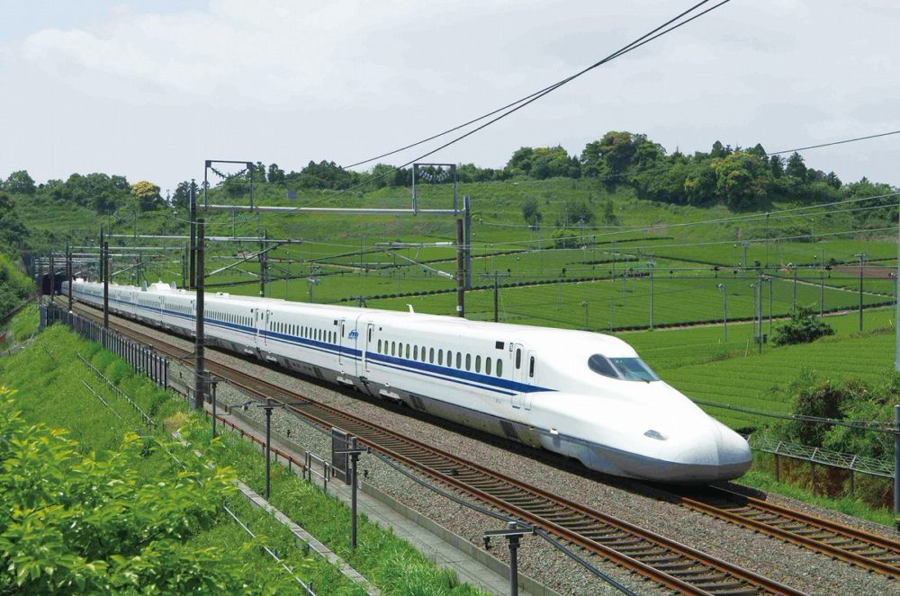
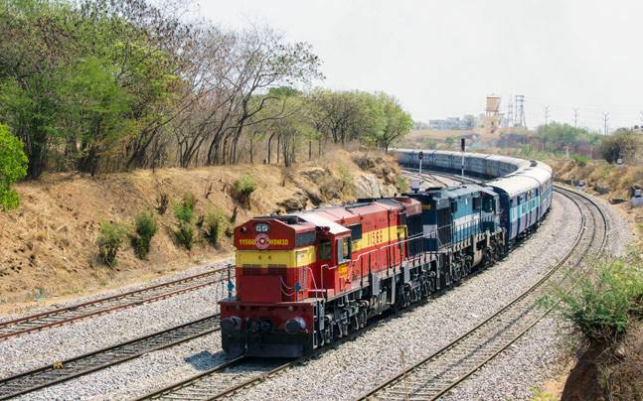
Concept of HRM
R.W. Griffi

Slide 11
Features of a motor bogie:
i. Carries all bogies together
ii. Makes the path
iii. Keeps all to the destination
iv. And more importantly bears the heat of coal or electricity alone
So as a leader

Slide 12
Concept of a leader
S/he is the leader who has the clear and communicable vision and conviction that a dream can be achieved.
S/he is the leader who energize followers by providing exciting vision for the future
S/he is the leader who inspires the power and the energy to get it done.
S/he is the leader who knows the way, goes the way and shows the way.
S/he is the leader who is answerable for the performance.

Slide 13
Concept of a leader
The only definition of a leader is someone who has followers-Peter Drucker
If your actions inspire others to dream more, learn more, do more and become more, you are a leader- America’s Sixth President John Quincy Adams
In summary, leader is the person who:
Leads the group or followers
Influences the behaviour of others
Possess the leadership skills
Attain the common goal through their influence

Slide 14
Concept of leadership
It is the process through which leaders influence the values, behaviour and attitude of others.
It is an act of motivating team members not only to perform well but also in case of failure.
It is influence, nothing more, nothing less.
Leadership is like parenting.

Slide 15
Concept of leadership
It is the ability to influencing a group toward the achievement of goal.
It is the process of influencing people and providing an environment for them to achieve team or organisational objectives.
Leadership is defined as influence that is, the art or the process of influencing people to that they will strive willingly and enthusiastically toward the achievement of group goals.

Slide 16
Concept of leadership
Leadership can be defined as three broad categories;
Leadership as a process: Leadership uses its influence of position to direct, motivate, and coordinate the group activities to achieve the organizational goal.
Leadership as a property: Leader possess basic characteristics to influence the group activities successfully.
Leadership as a power: Power is synonymous with action. It is the means of getting things done or making things happen.

Slide 17
Basic features of leadership
Leadership is a vision
Leadership is the ability to create a bond
Leadership is to make people work together
Leadership is the patience of believing others
Leadership is the art of taking responsibility of outcomes
Leadership is something the leader does, not something s/he has

Slide 18
Discussion issue: What is human relations?

Slide 19
THE LIFEBLOOD OF AN ORGANIZATION IS ITS
PEOPLE

Slide 20
Human Relations; concept
The concept is propounded by Elton Mayo and his associates via Hawthorne experiment.
Human relations is the relations with or between, particularly in a workplace or professional setting.
Human relations refers to act humanly with the human.
Human relation theory is characterized by a shift in emphasis from task to worker.

Slide 21
Human Relations; concept
The theory emphasizes on social and psychological factors at work.
Human relations are the integration of people into a work situation that motivates them to work together productively.
Being together with other people and interacting with them.
It is the relationships between groups of people, especially between workers in a place of work. www.dictionary.cambridge.org

Slide 22
Base of human relations concept
People have feelings for those they work with.
They want to have a sense of belonging and significance while being treated.
Particular set of feeling affects job performance.
The happiness people experience when good things happen to their coworkers and vice-versa.
Group factor play a significant role in organizational performance.

Slide 23
Base of human relations concept
A leader’s/manager’s success depends on her/his ability to create a healthy human relations climate.
S/he needs to understand workers as human being with social and emotional needs.
Everyone has ego/dignity, that should be satisfied to make him/her ready to contribute the best.

Slide 24
Base of human relations concept
When coworkers can’t relate or build friendships at work, the company as a whole can become rigid and mechanical since people are unwilling to communicate or go much beyond their basic responsibilities.
On the other hand, when the staff feels connected and united, problem solving and innovation flourish.
The unity and common purpose established through good relations allow a company to function like a well-oiled machine.
(https://woman.thenest.com/importance-human-relations-workplace-3448.html)

Slide 25
Base of human relations concept
Conclusion of Hawthorne study by Mayo:
job satisfaction increased as workers were given more freedom to determine the conditions of their working environment and to set their own standards of output;
intensified interaction and cooperation created a high level of group cohesion;
job satisfaction and output depended more on cooperation and a feeling of worth than on physical working conditions.
informal groups are more stronger than the formal one.
communication between managers to worker and coworkers influence morale and thus output.
managers must take social needs, such as belonging to an informal groups.

Slide 26
Importance of human relations in management
To remove conflict between individual and organization
To remove individual differences
To achieve the goal of institution
To make a good working environment
To make a coordination between different sections
To improve quality and quantity of product
The better human relations, the more likely to grow both professionally and personally.

Slide 27
Benefits of better human relations
Increased loyalty: When employees are loyal to the company, they want to stick around and develop their skills more effectively. Retention rates can soar when you have a group of happy campers.
Mutual reinforcement: When workers feel they are part of something worthwhile and in sync with their fellow workers, they will catch and fix problems on their own.
(https://woman.thenest.com/importance-human-relations-workplace-3448.html)

Slide 28
Benefits of better human relations
Motivation and productivity: Employees who are interested in their work and in the well-being of other employees tend to be more productive than those who are not.
Fostering creativity: Employees' creativity is often dependent on their ability to communicate with other employees and share ideas. Without quality workplace relationships, employees are less likely to be able to develop and share the solutions that a business needs to survive. http://smallbusiness.chron.com/importance-human-relations-workplace-23061.html
Makes people desire to contribute; contribute beyond the expectation.

